Slide 1
QXU4004 Engineering Materials
Dr Sulafudin Vukusic
s,.vukusic@qmul.ac.uk

Slide 2
Suggested Reading List:
Chapters 1, 2, 3 and 10 (10.1-10.4): “Organic Chemistry” by Francis A. Carey & Robert M. Giuliano (10th Edition, McGraw-Hill Education, 2017).

Slide 3
QXU4001 Molecules to Materials
Introduction to Organic Chemistry and Free-Radicals

Slide 4
Revision:
Please revise orbitals (In particular Week 2 Lecture Notes 1 on Molecular Orbitals and Hybridisation: specifically the notes at the end on bonding in carbon compounds
Please see the videos on hybridisation (from QMPLUS)

Slide 5
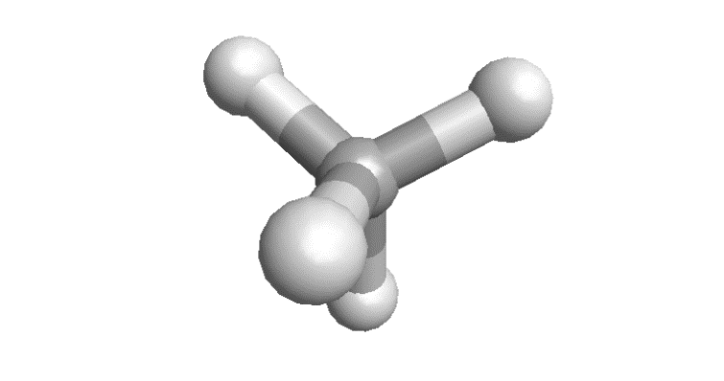
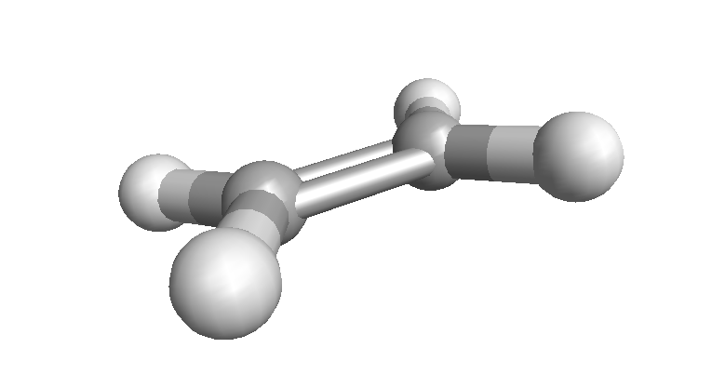
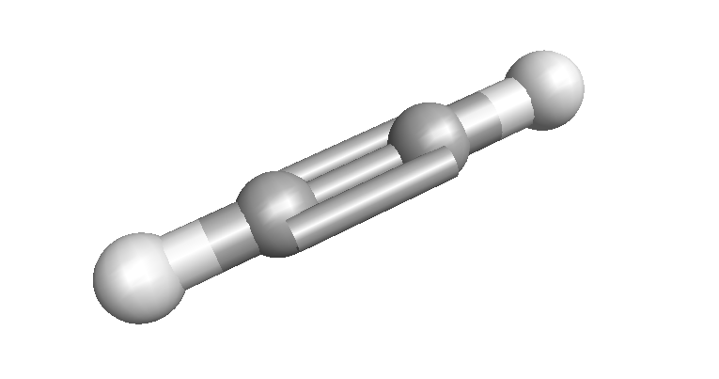
Bonding in carbon compounds
The geometry of C compounds is not well explained by using the simple 2s, 2p_{x} and 2p_{y} orbitals
Experimental geometries are found to be tetrahedral (Td), trigonal planar (Tg) or linear (Lr)

Slide 6
sp³ Hybridisation
The correct C geometry can be obtained from the AOs by hybridisation, i.e. mixing of the 2s, 2p_{x}, 2p_{y} and 2p_{z} orbitals
This gives 4 new equivalent hybrid orbitals
Each with 1 electron
Pointing to the corners of a tetrahedron

Slide 7
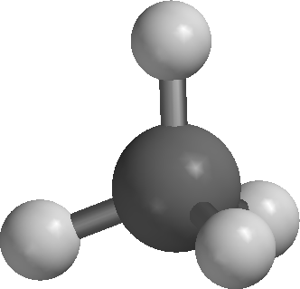
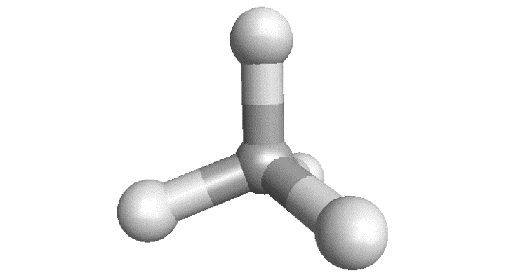
sp³ Hybrids and σ bonds
Overlap of a C sp³ hybrid with a H 1s gives a C-H σ bond
Each contributes 1 electron, so the σ MO (or bond) has 2 electrons and is filled
Repeating this for all hybrids gives 4 x C-H σ bonds and the molecule methane

Slide 8
C_{sp3}-H σ bonds
What does this C sp³ and H 1s interaction look like in MO terms?
The overlap creates a C-H σ bonding MO (or more simply a C-H σ bond) with 2 electrons
And a C-H σ* anti-bonding MO which is empty

Slide 9
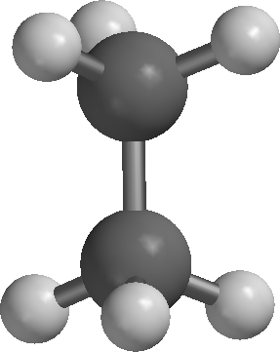
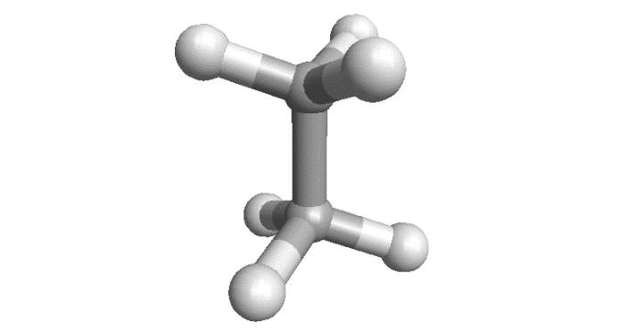
C_{sp3}-C_{sp3} σ bonds
An sp³ hybrid on one C can overlap with an sp³ on another C
A C-C σ MO (or σ bond) is formed
If the remaining sp³ orbitals form bonds to H, this gives ethane
If further sp³ C are added, this gives propane, butane, etc.

Slide 10
C_{sp3}-C_{sp3} σ bonds
The overlap creates a C-C σ bonding MO (or more simply a C-C σ bond) with 2 electrons
And a C-C σ* anti-bonding MO which is empty
Note: Do not worry if the shapes are not identical to other pictures, e.g. slide 11, or Bruice, p29. It is the general concept (orbital density between atoms for bonding, ‘gap’ in orbital density for anti-bonding, etc.) that is important here

Slide 11
sp² Hybridisation
A second C geometry can be obtained by part hybridisation, i.e. mixing of the 2s, 2p_{x}, 2p_{y,} but not the2p_{z}
This gives 3 new equivalent hybrid orbitals, in a planer geometry, but leaves the 2p_{z} unhybridised
Each orbital has 1 electron, including the p_{z}

Slide 12
C_{sp2}-H and -C σ bonds
sp² hybrids have a shape similar to the sp³ (a little more ‘rounded’) but are oriented towards the corners of a triangle; trigonal or planar geometry
As for methane, the sp² hybrids can overlap with H 1s, C sp² (or C sp³) to give C-H and/or C-C σ MO (or σ bonds)

Slide 13
C_{sp2}-C_{sp2} π bonds
Sideways overlap of the unhybridised p_{z} AOs gives a C-C π MO (or π bond)
This contains the last two electrons and is both above and below the plane
Note: Again, do not worry if the shapes are not identical to other pictures or differently coloured, e.g. slide 12, It is the general concept (orbital density between atoms for bonding.) that is important here

Slide 14
sp Hybridisation
A third C geometry can be obtained by mixing of the 2s and 2p_{x}, but not the 2p_{y,} and 2p_{z}
This gives 2 new equivalent hybrid orbitals, in a linear geometry
Each orbital has 1 electron

Slide 15
C_{sp2}-C_{sp2} π bonds
As before, the hybrid sp overlap with H 1s or C hybrids to give C-H and/or C-C σ MO Sideways overlap of the unhybridised p_{z} AOs gives a C-C π MO above/below the ‘plane’
Sideways overlap of the unhybridised p_{y} AOs gives a C-C π MO in front/behind the ‘plane’

Slide 16
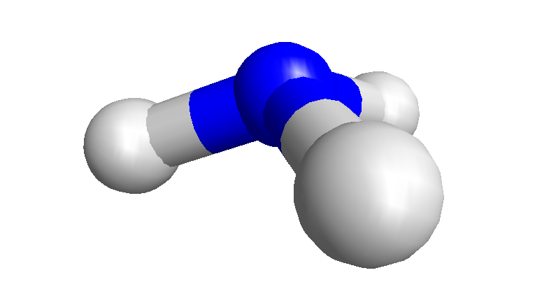
sp³ Hybridisation at N
Hybridisation can be applied to other atoms, e.g. N
Mixing of the 2s, 2p_{x}, 2p_{y} and 2p_{z} orbitals gives (as for C) 4 new equivalent hybrid orbitals
Pointing to the corners of a tetrahedron
But now ONE must take 2 electrons; this is called a LONE PAIR
The remaining 3 bond to H 1s, or C (sp³, sp² or sp)

Slide 17
sp³ Hybridisation at O
Hybridisation can be applied to other atoms, O, halogen (e.g. F)
The hybrids are populated singly, before in pairs (called lone pairs)
The remaining singly occupied hybrids bond to H 1s, or C (sp³, sp² or sp)

Slide 18
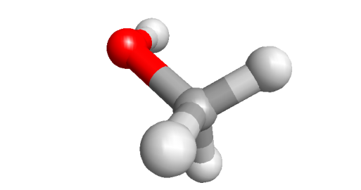
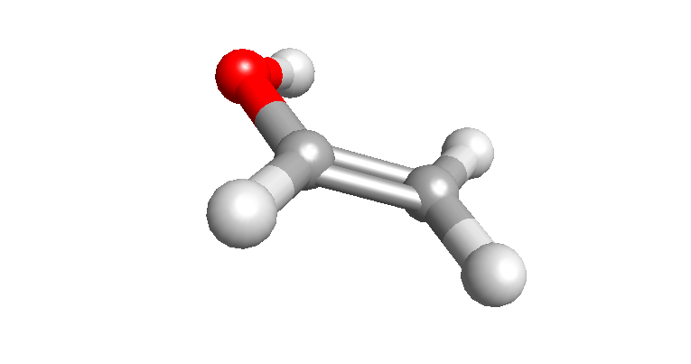
sp³ Hybridisation at O (N,F)
Bonding sp³ O to sp³ C gives methanol, methyl amine and fluoromethane
Bonding sp³ O to sp² C gives vinyl alcohol, amino ethene and fluoroethene
.. and so on

Slide 19
sp² Hybridisation at O
As with C, sp² hybridisation of O gives 3 new equivalent hybrid orbitals, in a planer geometry, with the 2p_{z} unhybridised
The first 4 electrons fill each orbital, including the p_{z,} singly to begin with
The 5th electron ‘pairs up’ in an sp², while the 6th pairs up in another sp² (note)

Slide 20
sp² Hybridisation at O
If the ‘single electron’ sp² overlaps with an sp² (see earlier slide for C), a O_{sp2}-C_{sp2} σ bond is formed
The unhybridised p_{z} orbitals, as for ethene, overlap ‘sideways’ to O-C π bonding MO (or a π bond)
Note: Don’t forget that each MO (σ or π) has corresponding anti-bonding MO that has not been shown in the recent slides

Slide 21
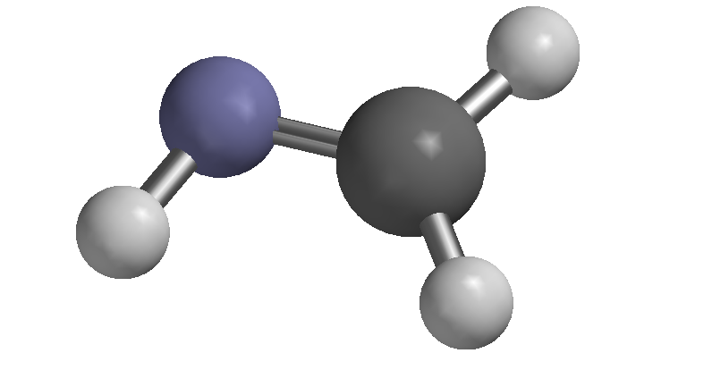
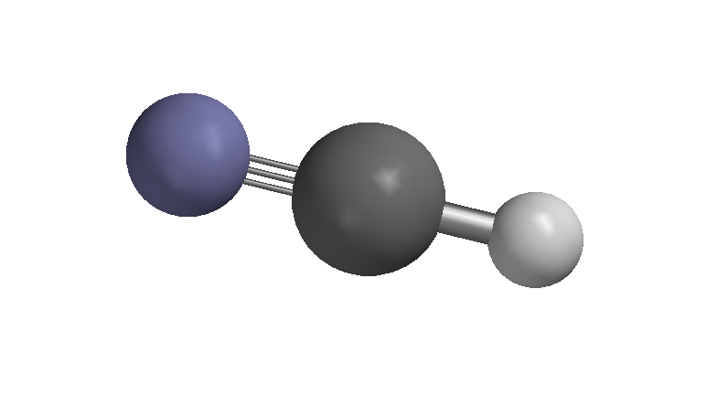
sp² sp Hybridisation at N
Try at Home: Analyse the bonding, in terms of hybrid orbitals and MOs for methanimine and hydrogen cyanide

Slide 22
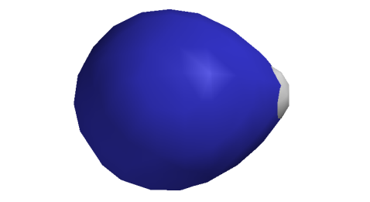
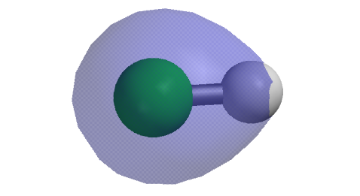
Polarisation and partial charges
All MOs have been shown evenly distributed, but this is not entirely accurate
An electronegative atom will pull shared electron towards itself so the probability is that the electrons spend more time on that atom’s side of the covalent bond
This can be qualitatively shown by distorting the orbital (which can reflect probability anyway)
This results in a slight (-) charge on F and slight (+) on H; these are rarely quantified, but shown as δ- and δ+

Slide 23
Empty orbitals
Hybridisation can also be applied to atoms with fewer electrons than C, for example B
Normally, sp² hybridisation is favoured (it keeps the bonding pairs furthest apart)
But it can re-hybridise to sp³ if necessary

Slide 24
Summary of orbitals and bonding
ANY orbital, atomic (1s, 2s, 2p_{x}, etc.), hybrid (sp³, etc.), or molecular (σ, σ*, π, π*) on one atom can POTENTIALLY ‘overlap’ (‘interact’, ‘bond’, etc.) with any orbital on another atom (or even group of atoms in the case of MOs), … subject to certain conditions ...
Orbitals must be geometrically capable (e.g. close, correctly oriented ), reasonably close in energy, and of same symmetry (important, but mainly for MOs)
This ‘overlap’ or ‘interaction produces 2 new molecular orbitals, one lower in energy, the other higher
Orbitals (satisfying the above) WILL ‘overlap’ if their electrons become lower in energy by doing so
This overlap DOES occur (to give a σ-bond) because the two electrons, formerly in sp³ hybrids) both end up in a lower energy σ-MO

Slide 25


Interaction of filled and empty orbitals
Obviously, for two EMPTY orbitals there is no point in interacting, there are no electrons to be lowered!
For two FULL orbitals there is no point because, 2 electron would end up in the lower energy ‘bonding’ MO (e.g. σ), and 2 in the higher energy ‘anti-bonding’ (e.g. σ*), cancelling each other out
But, what about FULL-EMPTY?

Slide 26
Ammonia-boron trihydride
A good example of a filled-empty interation is ammonia-boron trihydride H₃N:BH₃
NOTE: the atom providing the FILLED orbital GAINS a +1 charge; the atoms providing the EMPTY orbital GAINS a -1 charge
The FILLED species is called the DONOR, NUCLEOPHILE or LEWIS BASE
The EMPTY species is called the ACCEPTOR, ELECTROPHILE or LEWIS ACID

Slide 27
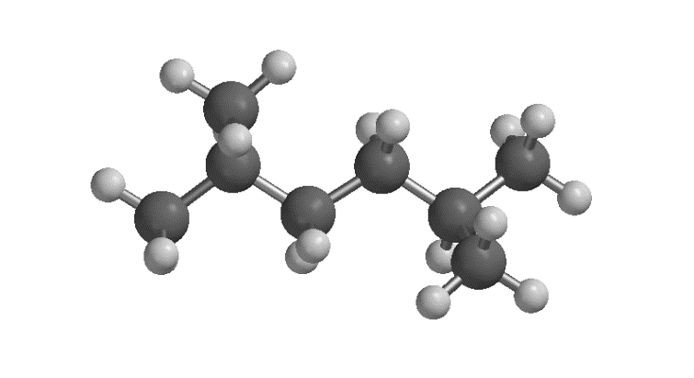
Representations of organic compounds
With Td C, 3-D organic compounds can be complex
They are often simplified to ‘flat’ drawings
Or to ‘condensed’/’displayed’/’structural’ formula
Or to skeletal formula (‘line’ drawings)

Slide 30
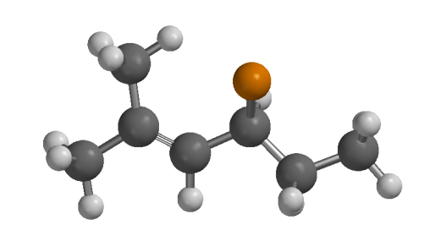
Skeletal formula (“Line drawings”) of organic compounds
Each bond ‘junction’ or ‘kink’, or ‘end’ is a C
Multiple bonds and heteroatoms (not C or H) are shown explicitly
Any non-explicit C valency is made up by H
Irrespective of how a molecule is drawn, the geometry at C is determined by hybridisation

Slide 32
The Hierarchy（等级制度） of Isomerism

Slide 33
Constitutional Isomers（结构异构体）
Some examples of constitutional isomers
Alkane isomers
Different functional groups
Different heteroatom positions

Slide 34
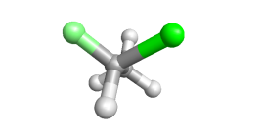
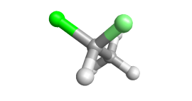
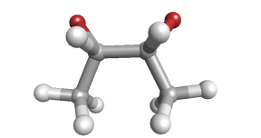
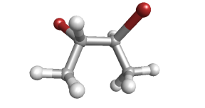
Stereoisomers（立体异构）
We will not look into stereoisomers in this module, but the topic is shown here for your reference
Stereoisomers differ in spatial configuration. Some examples are shown.

Slide 35
Enantiomers（对映体）
We will not look into stereoisomers in this module, but the topic is shown here for your reference
Enantiomers are MIRROR-IMAGE isomers, but only IF NON-SUPER-IMPOSABLE
This is obvious for the simple chloro-fluoroethanes
But more complex for the dibromo-butanes
(2S,3R)-dibromobutane is SUPERIMPOSABLE on its mirror image, so the structures shown are NOT enantiomers
In fact, (2S,3R)-dibromobutane does not HAVE an enantiomeric form

Slide 36
Enantiomers
We will not look into stereoisomers in this module, but the topic is shown here for your reference
The same process for (2R,3R)-dibromo-butane is NON SUPER-IMPOSABLE on its mirror image, so the structures shown are ARE enantiomers
So, (2R,3R)-dibromobutane has an enantiomeric form called (2S,3S)

Slide 37
Diastereomers（非对映异构体）
We will not look into stereoisomers in this module, but the topic is shown here for your reference
So, 3 stereoisomeric forms of 2,3-dibromobutane are possible
Two are related as enantiomers, but what is the remaining relationship?
This is DIASTEREOMERIC

Slide 38
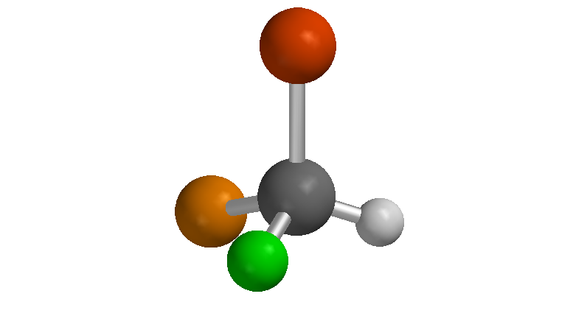
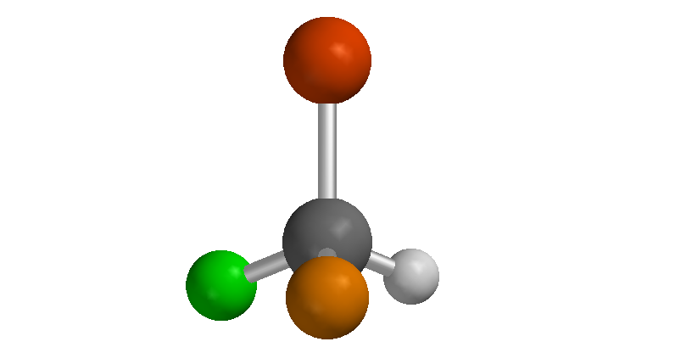
Specifying configuration
We will not look into stereoisomers in this module, but the topic is shown here for your reference
A C that gives rise to stereoisomerism（立体异构） is called a stereogenic or chiral carbon（手性碳）
To specify configuration about EACH stereogenic C , the Cahn-Ingold-Prelog system is used
The system requires a 3-D view

Slide 39

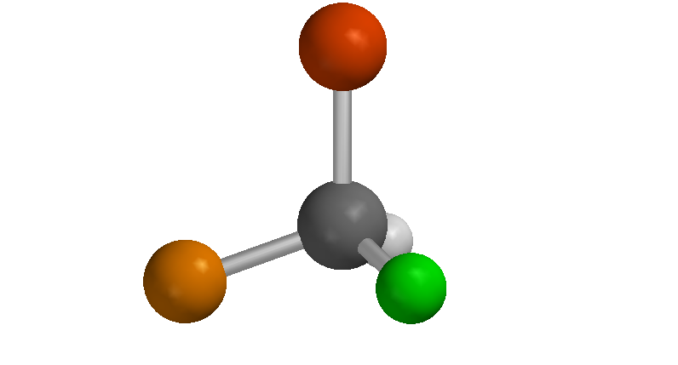
C-I-P (Cahn-Ingold-Prelog) configuration (CIP is the name of those who proposed it)
We will not look into stereoisomers in this module, but the topic is shown here for your reference
select the stereogenic C
assign priority based on decreasing atomic number of first atom of attached group
View in 3-D with atom (4) behind C
If 1-2-3 is anticlockwise it is S if clockwise R

Slide 40
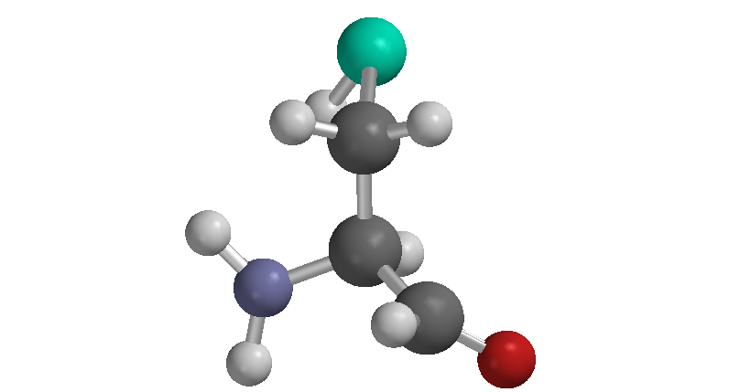
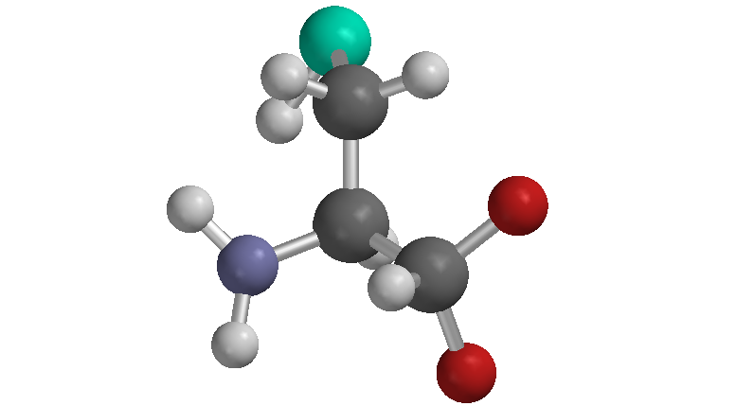
C-I-P for complex systems
We will not look into stereoisomers in this module, but the topic is shown here for your reference
For priority, if first atom is the same, consider second atoms
Multiple bonds are considered as two (or three) single bonds
So, R-cysteine

Slide 41
Z,E isomerism
Double bond prevents rotation
So cis and trans isomers are possible
Nowadays called Z and E
Different physical and chemical properties

Slide 42
Reactivity: functional groups
C-C and C-H σ-bonds are unreactive
Most reactions occur at C=C multiple bonds or C-X (X = heteroatom) bonds
These are functional groups (FG)
CH next to (α-position) FG may show some reactivity
Because organic compounds will invariably contain C and H, all the other atoms are usually referred to as “heteroatoms”（杂原子）

Slide 44
‘Curly’ arrows
Reactions involve breaking a bond between atoms, and forming new bonds
This is depicted by showing the ‘movement’ of the two electrons that comprise the bond as a ‘curly’ arrow
NOTE the (+) charge on the atom (C’) left ‘without’ its original electron (the number of atoms AND the number of charges before and after the reaction must stay the same!)

Slide 45
Empty orbitals
NOTE that electrons move, but orbitals do not (although the hybridisation may change)
The π-bond was formed from a p_{z} on C and another on C’
When the π-bond breaks, the C takes both electrons into its p_{z} and uses them to bond to H⁺
C’ is left with an empty p_{z} and a (+) charge
C rehybridises to sp³ to σ-bond to H

Slide 46
Nucleophiles and elecrophiles
A common reaction is where an atom uses its lone pair to bond to another with an empty orbital or ready to receive this lone pair to form a new bond
This is the type of interactions we saw in Lewis acids and bases
In Organic Chemistry we call the Lewis base, in this context, a “nucleophile” and the Lewis acid, in this context, an “electrophile” (the suffix “phile” comes from the Greek word “to love”)
Please note, the terms Lewis Acid/Base do NOT disappear in Organic Chemistry: “nucleophile/electrophile” refer to a kinetic behaviour (the role of a species in a reaction pathway or mechanism), while “acid/base” refer to a thermodynamic behaviour (which species behaves more or less strongly as an acid/base pair in the classical meaning of acid/base we have seen before)
In the example here, Cl⁻ is the nucleophile, and C⁺ is the electrophile

Slide 49
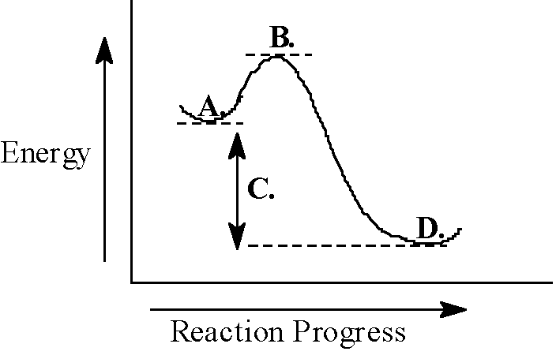
General reaction energy profile
A = reactants
B = Transition state
C = reaction free energy (ΔG)
D = products
The ΔE(B-A) is called the activation energy
Note: This is for a single-step reaction, or a single step of a multi-step reaction

Slide 50
Reaction kinetics

Slide 51
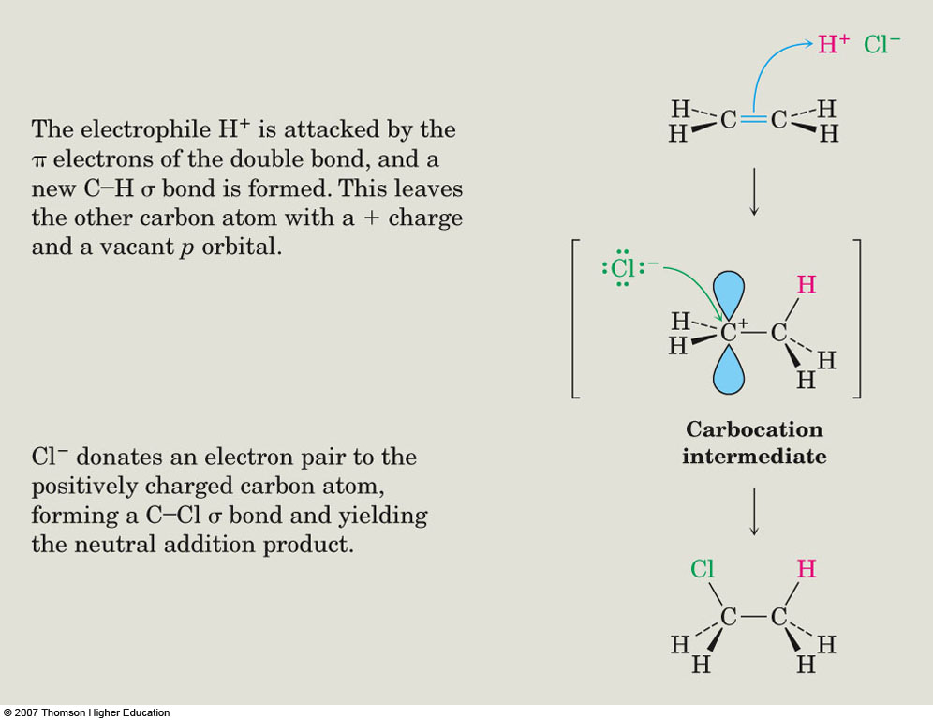
Reactive intermediates
The two step reaction shown earlier gives an initial high energy product, a reactive intermediate
A ‘reactive’ intermediate is one that exists only briefly (typically < 1 ms) during a reaction
It is rarely detected directly
The C⁺ species is a carbenium ion intermediate

Slide 52
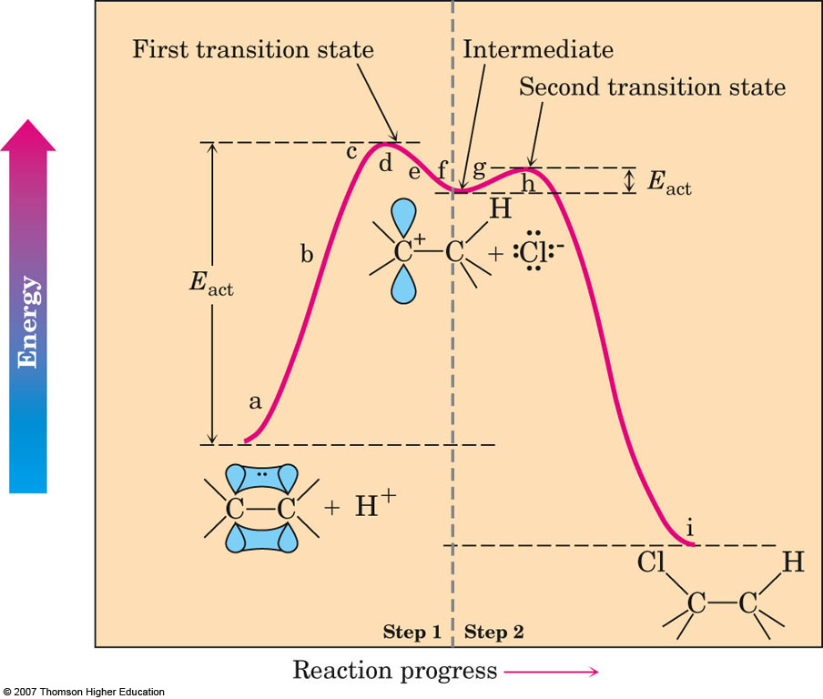
Reaction energy diagram for 2 stage

Slide 53
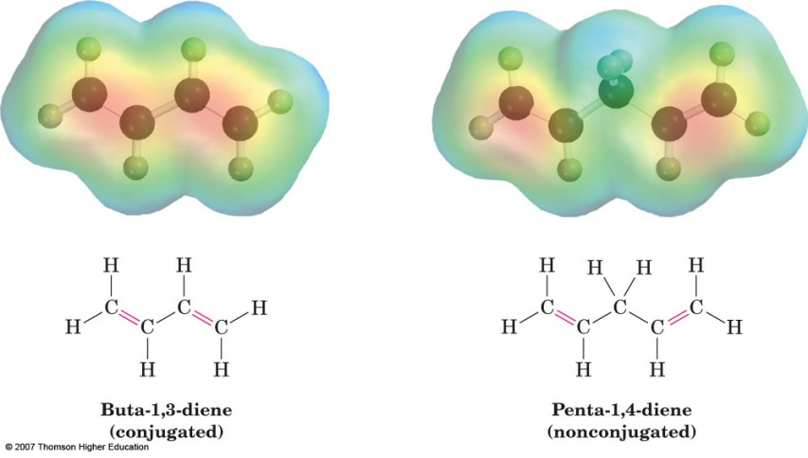
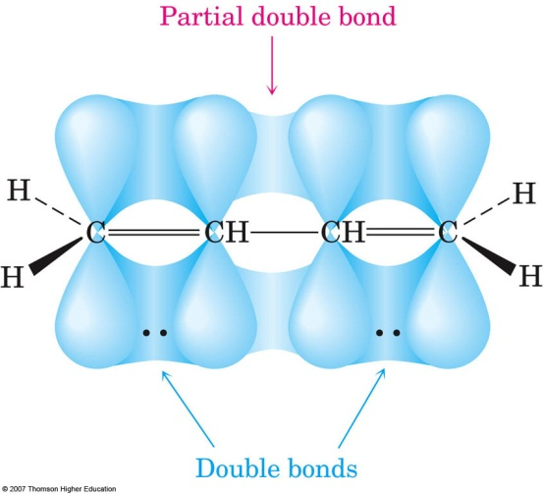
Conjugation - dienes
A diene contains two C=C
If these are in alternating positions they are conjugated
This means that the p_{z} orbitals of each C=C show some overlap

Slide 54
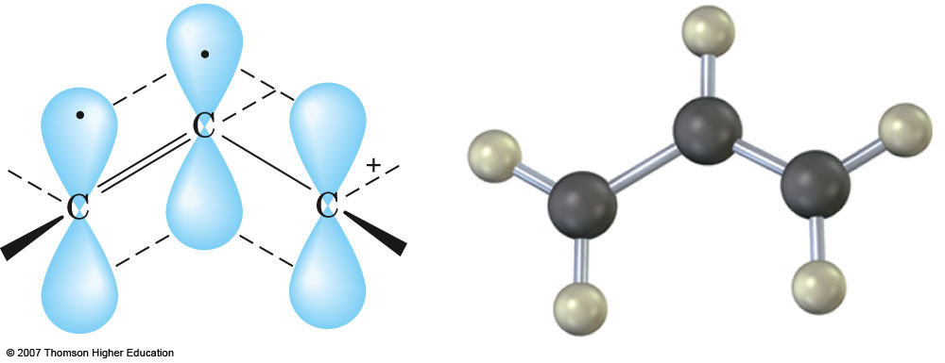
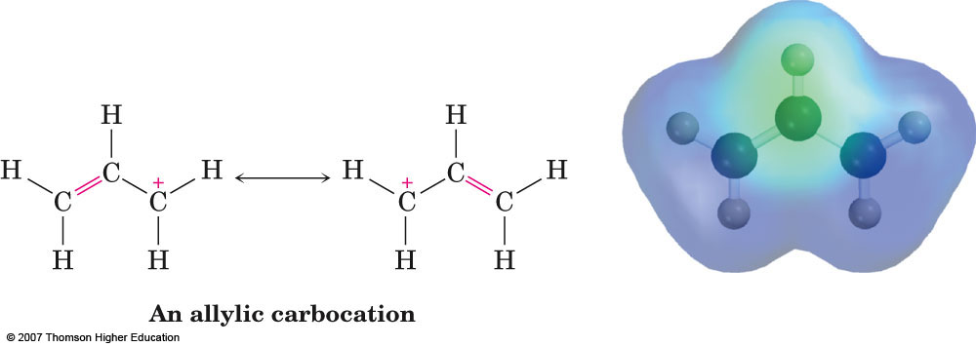
Conjugated carbenium ion
Similar overlap can occur with the empty p_{z} of a carbenium ion
This gives an MO composed from three AOs and with 2 electrons that extends over 3 atoms
An important consequence of this is that the (+) is delocalised over the two end carbons
The single (+) is delocalised and easier for the molecule to bear; it is stabilised

Slide 55
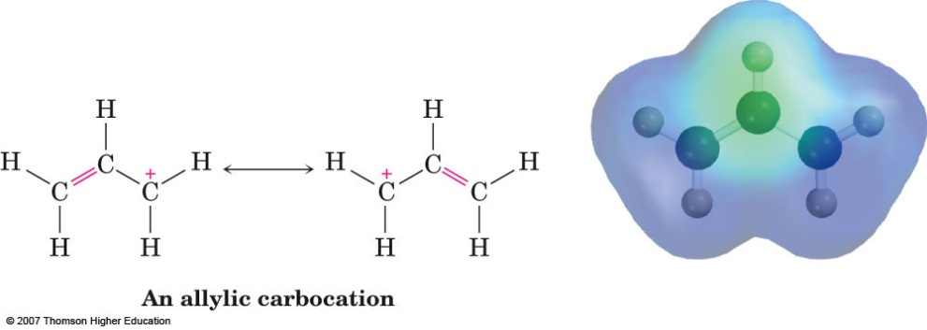
Resonance forms
Such ‘delocalised’ structures are easy best explained by MO theory, but these are hard and slow to draw
An easier way is to regard the ‘true’ structure is a merging of two resonance forms
These can be shown using ‘curly’ arrows
Note: Resonance forms are NOT separate molecules (as in an equilibrium); they are merely two drawings that try to represent a single structure
Note: The single line arrow

Slide 57
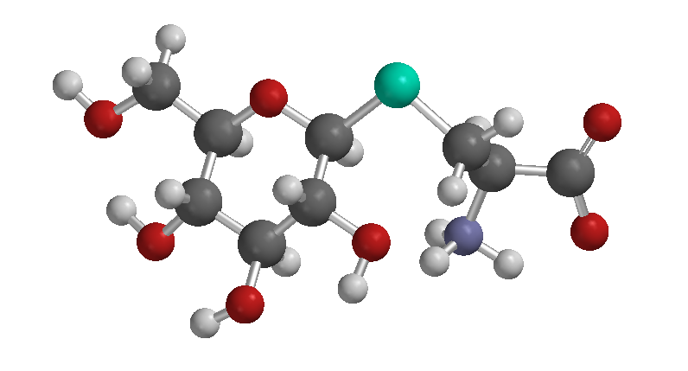
Aliphatic Chemistry
Aliphatic chemistry
Alkenes: structure & reactivity
Halogenoalkanes: nucleophilic substitution and elimination
Alcohols
Alkanes: free radical halogenation
The carbonyl group in aldehydes and ketones (nucleophilic addition)
The carbonyl group a-carbon reactions
Amines
Carboxylic acids
Carboxylic acid derivatives
Grignard and related organometallic compounds

Slide 58
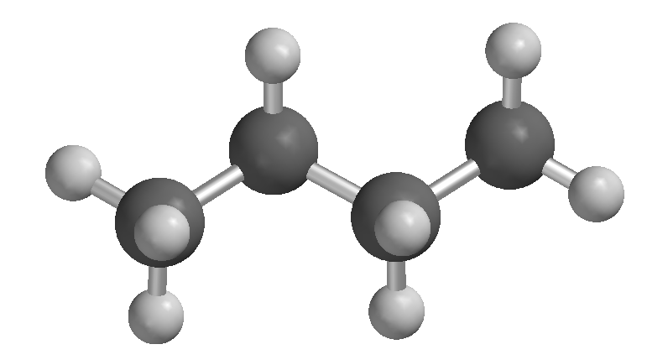
Alkanes

Slide 59
Structure and representation of alkanes
Acyclic alkanes have the empirical formula C_{n}H_{2n+2}
Cyclic alkanes have the empirical formula C_{n}H_{2n}

Slide 60
Alkyl groups in organic chemistry
An alkane fragment with one open valency is called an alkyl group
It is named by replacing –ane with -yl

Slide 61
Alkane nomenclature
Find the parent – the longest C chain
Prefix with substituent alkyl groups …
… numbering the parent from the end that results in the lower substituent position

Slide 62
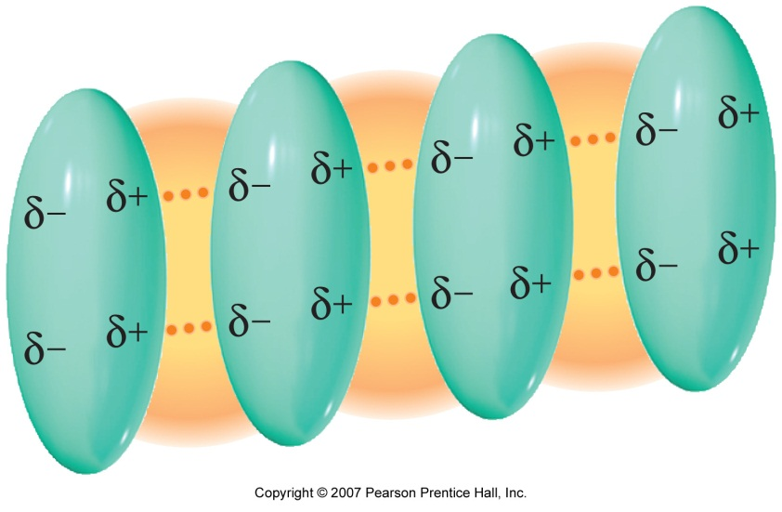
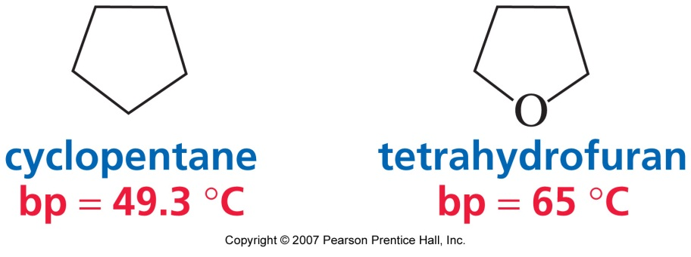
Physical properties of alkanes
C-C and C-H bonds are not strongly polarised
So, alkanes are non-polar molecules
Intermolecular forces are weak van der Waals
Bp, Mp, solubility in water are relatively low

Slide 63
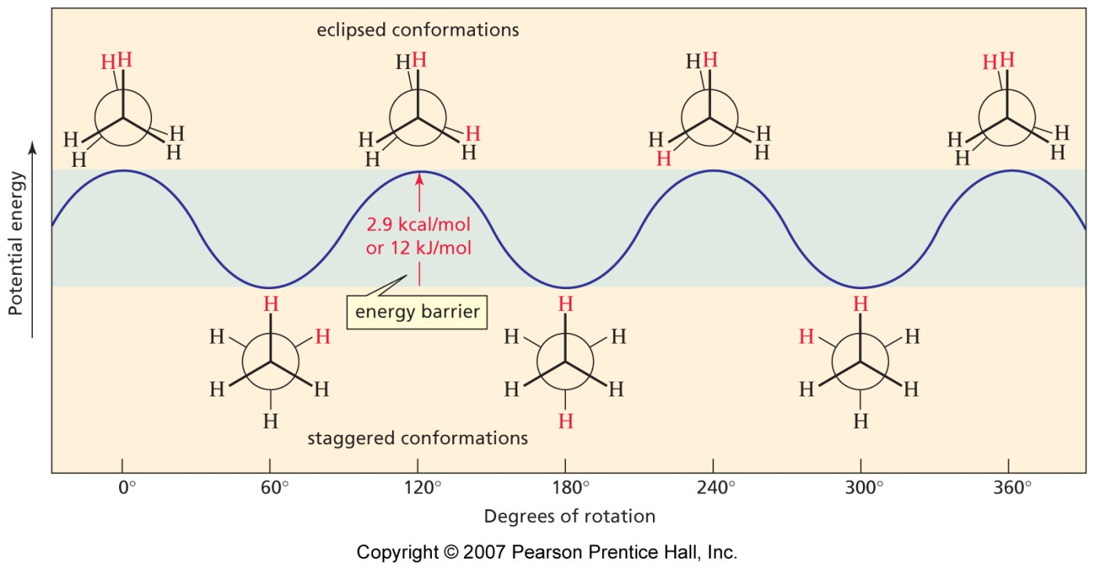
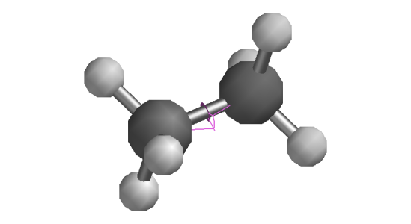
Conformation: staggered & eclipsed
Structures obtained by rotation about a single bond (σ) are called conformations; the simplest case is ethane
Note that no bonds are broken or altered in changing conformation
Two are particularly important, the staggered, and the eclipsed
C-H bond-bond repulsion is less (by 12 kJ mol⁻¹) in the staggered

Slide 64
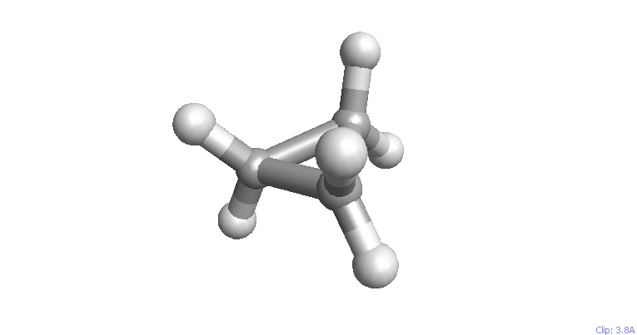
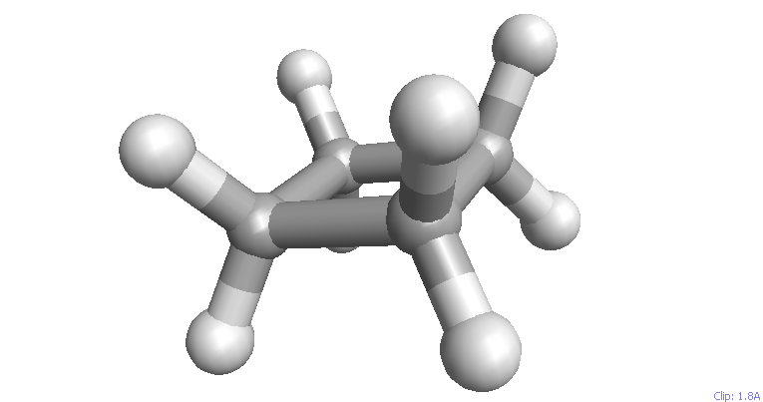
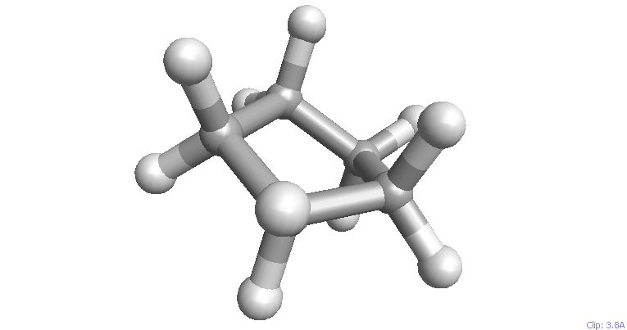
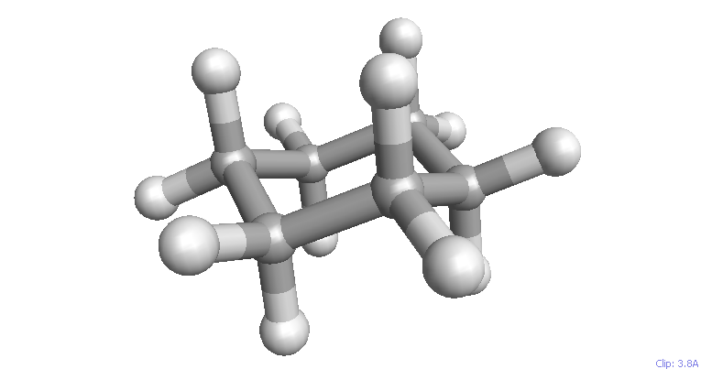
Cycloalkanes
Cyclopropane, cyclobutane and cyclopentane are all almost ‘flat
Cyclohexane cannot be constructed ‘flat’
It twists to a ‘chair’ conformation

Slide 65
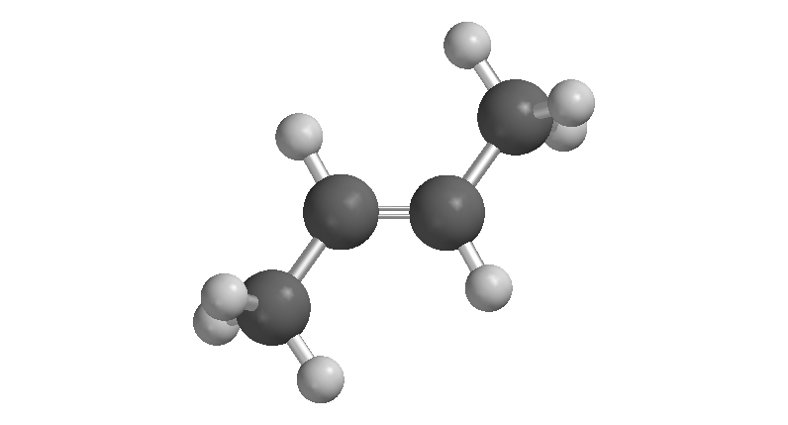
Alkenes

Slide 66
Alkenes: structure and representation
Acyclic alkenes have the empirical formula C_{n}H_{2n}
Cyclic alkenes are C_{n}H_{2n-2}
Alkene physical properties are very much like the alkanes; they are hydrophobic volatile liquids

Slide 67
Alkene nomenclature
Find the parent – the longest C chain, but it must contain the C=C – suffix -ene
Number the parent from the end that results in the lower C=C position
Prefix with substituent alkyl groups

Slide 68
Alkene isomerism
The restricted rotation about the C=C results in a form of diastereo-isomerism, often called geometric isomerism
1,2-disubstituted alkene isomers are often denoted by cis and trans
For tri, tetra-substituted, and (nowadays) for di-substituted, the (E),(Z) system is used

Slide 69
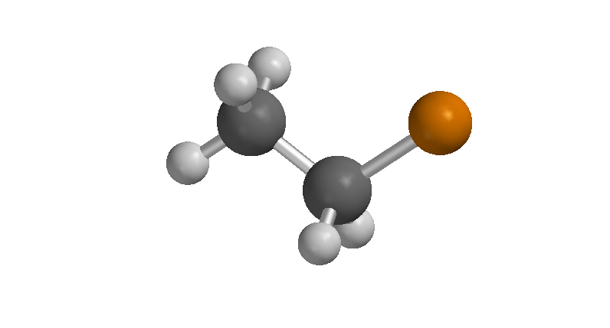
Alkyl Halides

Slide 70
Examples of alkyl halides

Slide 71
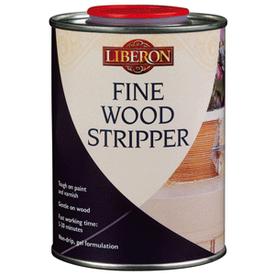
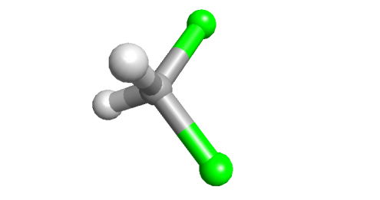
Nomenclature and properties
Choose the longest chain
Number from the end nearer the first substituent (X or R)
Prefix in alphabetical (not positional) order
Alkyl halide physical properties are very much like the alkanes; they are hydrophobic volatile liquids, although a little more polar than alkanes
Dichloromethane (CH₂Cl₂) is a common solvent

Slide 72
Alkyl halide preparations

Slide 73
Radical halogenation of alkanes (See Chapter 10.1-10.4)
The reaction proceeds in diffuse sunlight (can be explosive in strong sunlight), but heat can be used (~ 300 ºC)
F₂ is explosive, I₂ unreactive. Even with Cl₂ and Br₂ the reaction is difficult to control and gives mixtures
It is more convenient to use ‘radical initiators’ and other sources of halogen in the laboratory

Slide 74
Mechanism of radical halogenation
Initiation generates a few Cl radicals (atoms)
Cl radical takes H radical from methane to give H-Cl product and methyl radical
Methyl radical takes Cl from Cl₂ to give chloromethane product and a new Cl radical
The new Cl radical repeats the propagation step with new methane and Cl₂

Slide 75
Mechanism of radical halogenation
The rate-limiting step involves formation of a C radical
The reaction yield of the different products shows that a 2º radical is preferred to a 1º radical
Subsequent reaction with Cl₂ occurs at the radical, so a 2º product is favoured

Slide 76
Radical stability
The order of alkyl radical stability (i.e. ease of formation) is as shown
Primary, secondary, tertiary, means the number of carbons attached to the central C having the unpaired electron (shown as R)
resonance-delocalised radicals are also stabilised (allylic is slightly more stabilised than benzylic)
If these are included, the order is as shown

